Slide 1
Introduction to Quantum Computing: From a Layperson to a Programmer in 30 Steps
Hiu-Yung Wong
https://link.springer.com/book/10.1007/978-3-030-98339-0
https://www.amazon.com/Introduction-Quantum-Computing-Layperson-Programmer/dp/3030983382
Playlist: https://www.youtube.com/watch?v=TFKqf4pP3yw&list=PLnK6MrIqGXsJfcBdppW3CKJ858zR8P4eP&index=43

Slide 2
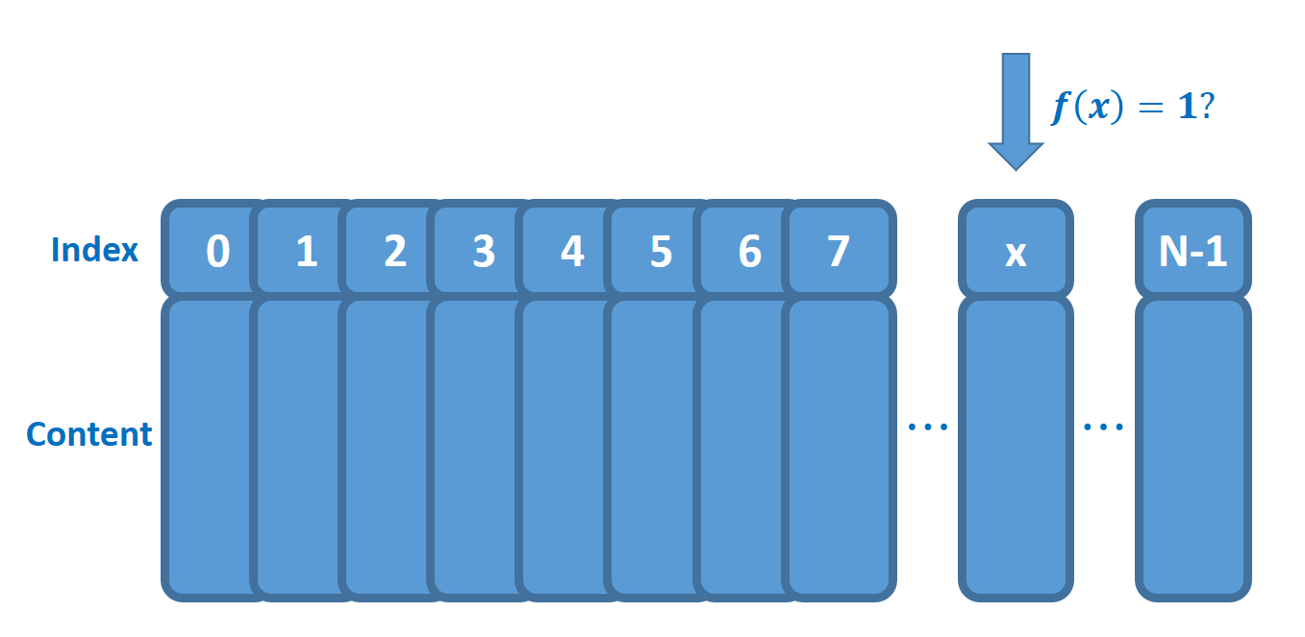

Grover’s Search Algorithm
N data in unstructured database
f(x==a) = 1 & f(x!=a) = 0
Average:
classical search
But: QC Grover’s algorithm

Slide 3
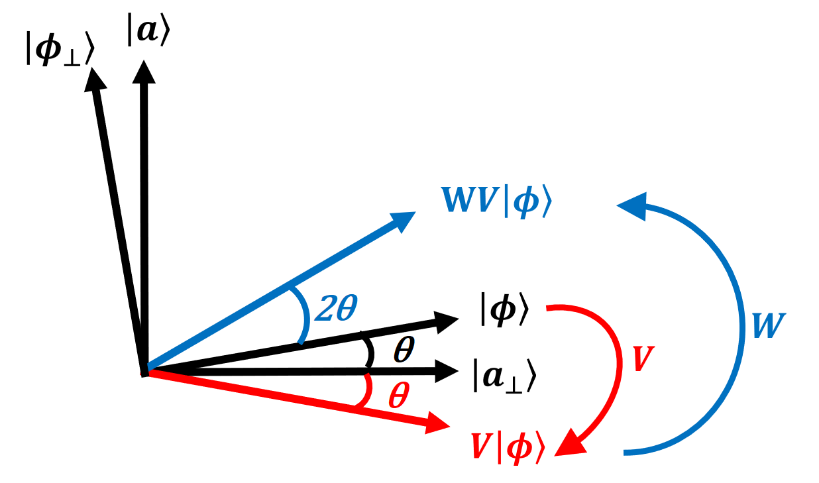
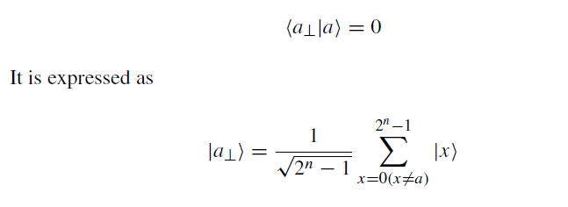
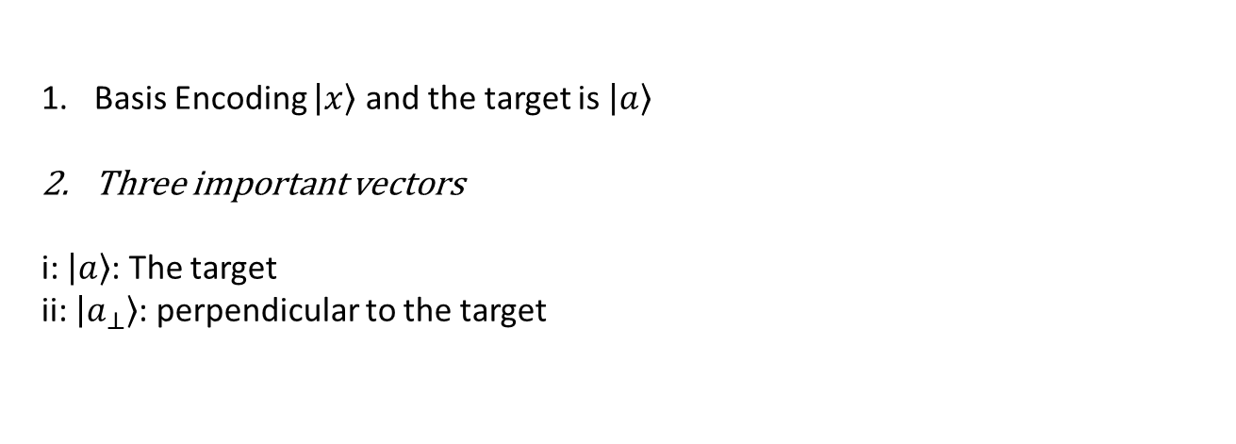
Overview of Grover’s Algorithm
Basis Encoding $\left|\left.x\right\rangle \right.$ and the target is $\left|\left.a\right\rangle \right.$
Three important vectors
i: $\left|\left.a\right\rangle \right.$: The target
ii: $\left|\left.a_{⊥}\right\rangle \right.$: perpendicular to the target

Slide 4

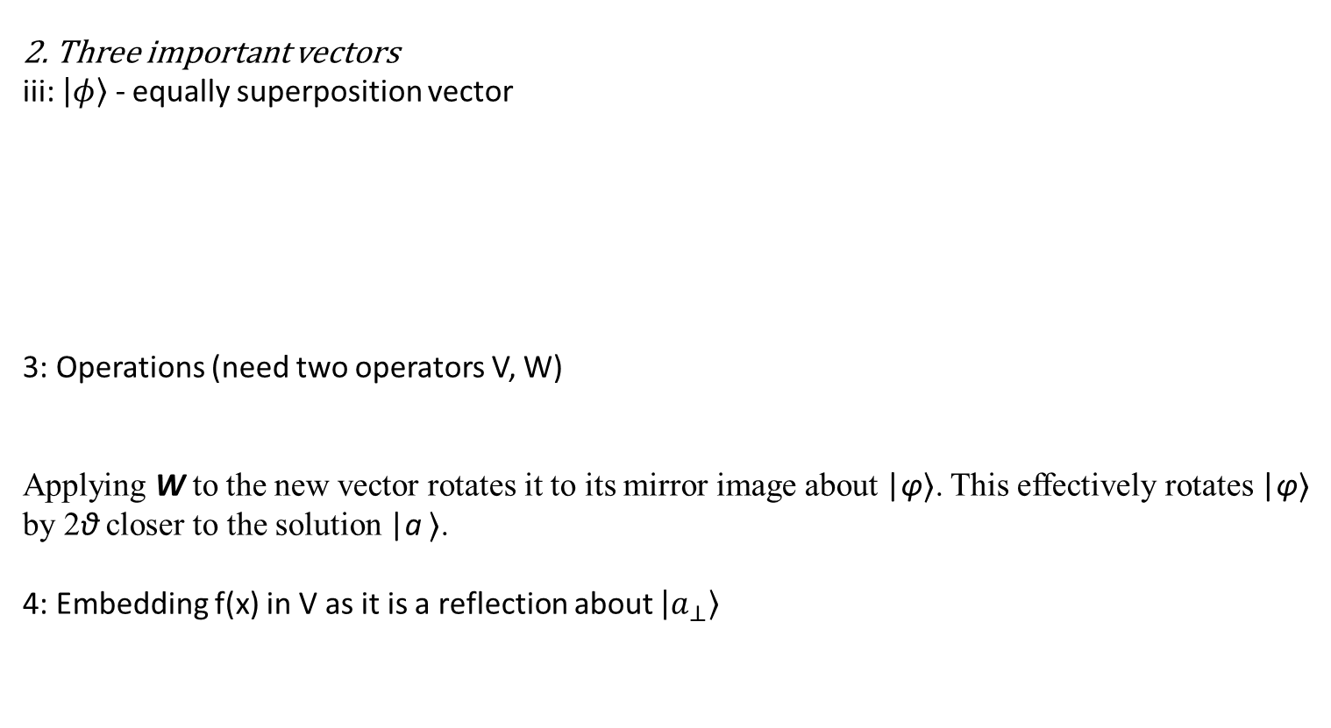
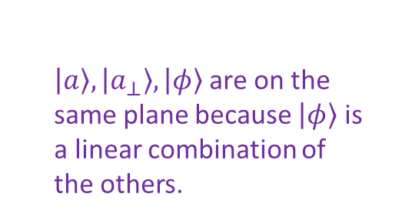
Overview of Grover’s Algorithm
2. Three important vectors
iii: $\left|\left.φ\right\rangle \right.$ - equally superposition vector
3: Operations (need two operators V, W)
Applying W to the new vector rotates it to its mirror image about |φ⟩. This effectively rotates |φ⟩ by 2θ closer to the solution |a ⟩.
4: Embedding f(x) in V as it is a reflection about $\left|\left.a_{⊥}\right\rangle \right.$
$\left|\left.a\right\rangle \right., \left|\left.a_{⊥}\right\rangle \right., \left|\left.φ\right\rangle \right.$are on the same plane because $\left|\left.φ\right\rangle \right.$ is a linear combination of the others.
Applying V to |φ rotates |φ⟩ to its mirror image about |a⊥⟩.

Slide 5

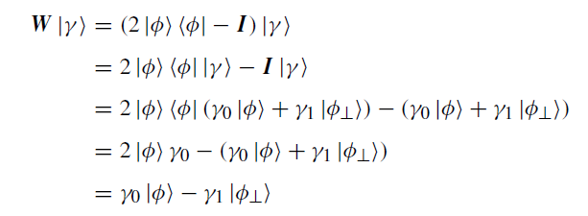
W-Operator

Slide 6
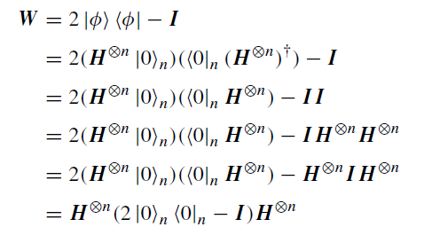
Implementation of W

Slide 7
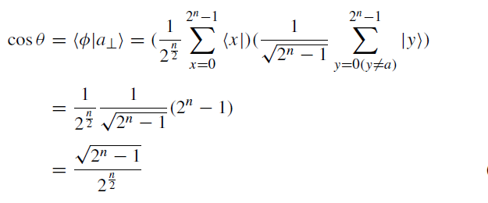



Angle between |a> and |φ>

Slide 8
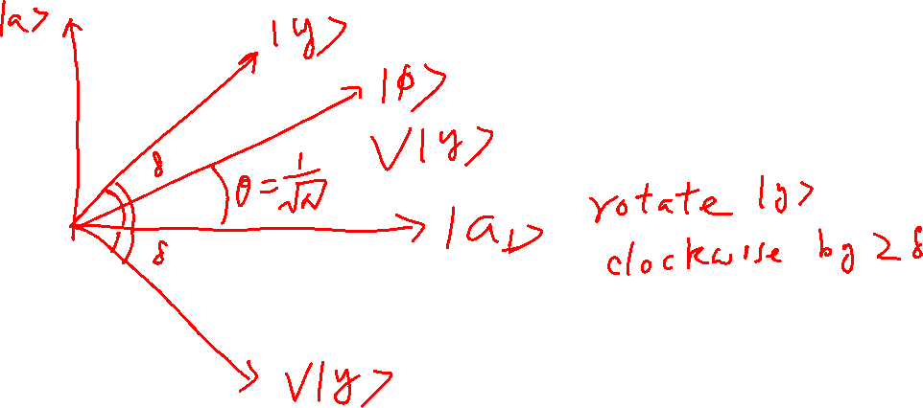
Effect of V on $|\left.y\right\rangle$(Graphically)- Keeps all basis vectors unchanged but flips the sign of $|\left.a\right\rangle$
Rotate
Clockwise by

Slide 9
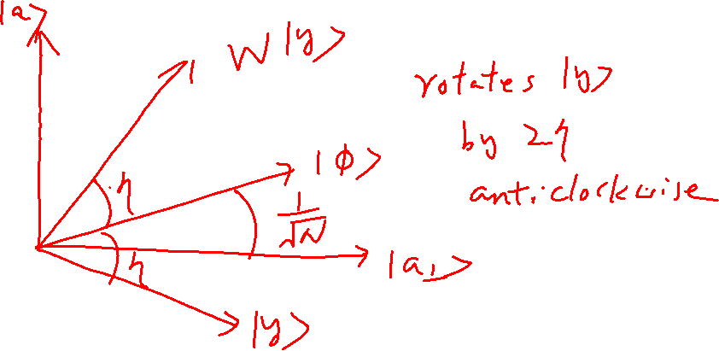
Effect of W (graphically) - Keep$|\left.Φ\right\rangle$ but flips the sign of $|\left.Φ_{⊥}\right\rangle$
Insert
by
Anti clockwise

Slide 10
Effect of W (graphically) - Keep$|\left.Φ\right\rangle$ but flips the sign of $|\left.Φ_{⊥}\right\rangle$
Insert
by
Anti clockwise

Slide 11

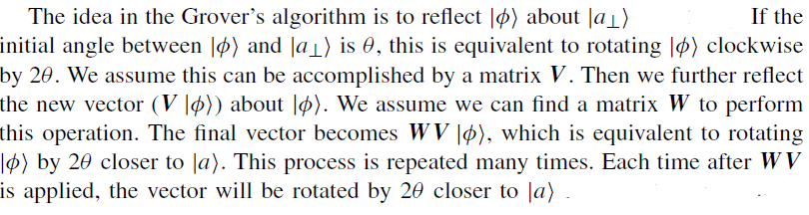
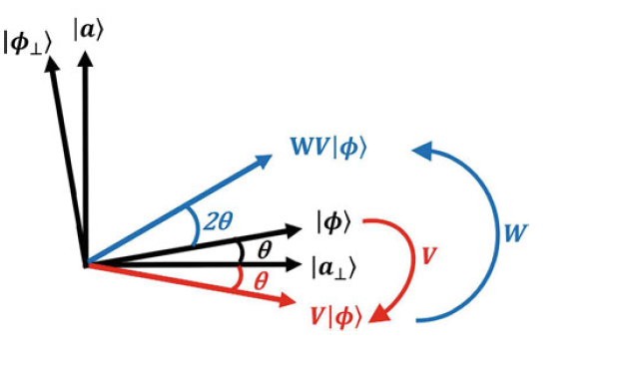
Effect of WV
Starts with |φ⟩ keep apply WV to get closer to |a⟩ by 2θ

Slide 12
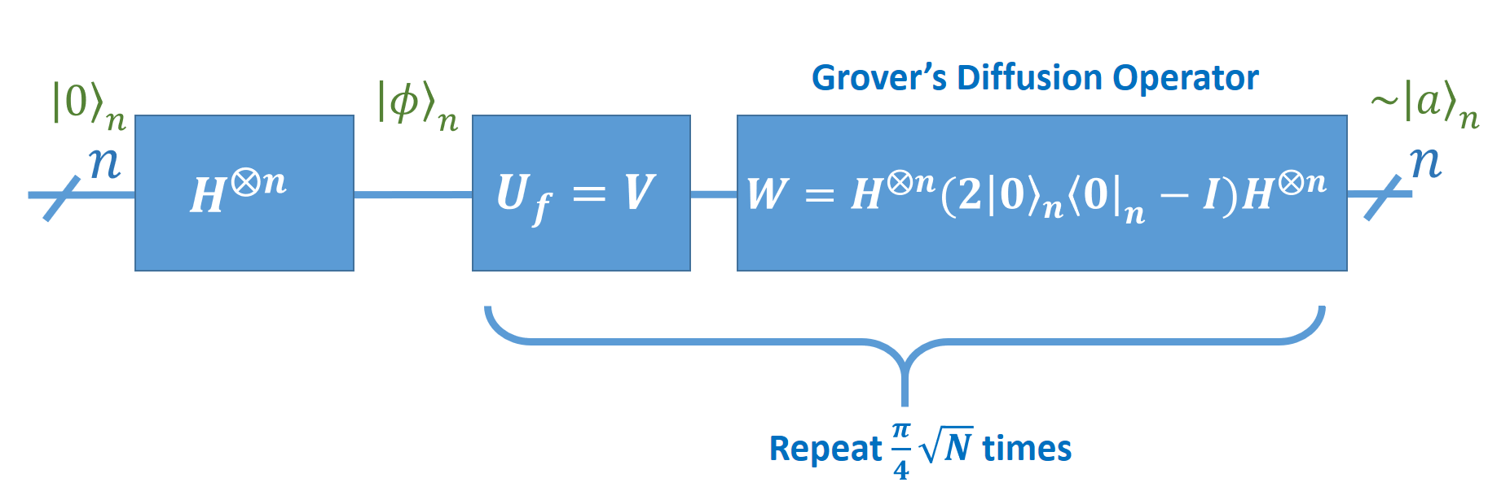

Implementation of Grover’s Algorithm

